Slide 1



City of Berkeley
Health, Housing and Community Services Department
Mental Health Division

Slide 2

Community Input Meeting
for the
Mental Health Services Act (MHSA)
FY24-26 Three Year Plan

Slide 3
MHSA BACKGROUND
Proposition 63 passed on November 2, 2004
Became effective as statute, Mental Health Services Act (MHSA) on January 1, 2005
1% of personal income over $1 million
Money is deposited into the MHSA Fund in the State Treasury
Funds are to be used to expand and transform the Mental Health System.

Slide 4

FUNDING COMPONENTS
Community Services and Supports (CSS)
Prevention and Early Intervention (PEI)
Innovation (INN)
Workforce Education and Training (WET)
Capital Facilities and Technological Needs (CFTN)

Slide 5

MHSA FUNDING
DISTRIBUTION/TIMELINES
Estimate local funds by State Estimates
Funding distributed monthly based on deposits into MHSA Fund
Monthly fund distribution fluctuates
Five year timeframes to expend CSS, PEI and INN
Use previous years unspent funds first

Slide 6


MHSA REQUIREMENTS
Three Year Plans
Annual Updates

Slide 7
STEPS TO AN APPROVED PLAN
Conduct a Community Planning Process that includes input from Consumers, Family Members and other MHSA Stakeholders.

Slide 8
PARTICIPANT SURVEY
https://www.surveymonkey.com/r/Y6MQVN6

Slide 9
COMMUNITY PROGRAM PLANNING
Write a Draft Plan
Conduct a 30-Day Public Review
Conduct a Public Hearing
Obtain approval from City Council

Slide 10
MHSA PLAN COMPONENTS
Report on Community Planning Process
Analysis of substantive comments received in 30-Day
Public Review Period
MHSA Funding Components (CSS, PEI, INN, WET, CFTN)
will include:
-Whether continuing services
-Whether funding new services
-Report on Program Data
-Projected Program Expenditure Plan
Cost Per Person on CSS/PEI/INN Services
PEI and INN Evaluation Reports

Slide 11
COMMUNITY PLANNING PROCESS
METHODOLOGY
Community Input
MHSA Advisory
Committee
Input
Staff Input
Department & Division

Slide 12

FY24 – FY26 PROJECTED REVENUE
FY24 | FY25 | FY26
$12,240,361 | $6,060,289 | $5,978,325
Once received, funding is locally distributed across the three annually occurring funding components as follows: 76% CSS, 19% PEI, 5% INN.

Slide 13
COMMUNITY SERVICES & SUPPORTS (CSS)
Programs/Services
*FULL SERVICE PARTNERSHIPS
*MULTICULTURAL OUTREACH & ENGAGEMENT
*SYSTEM DEVELOPMENT

Slide 14
FULL SERVICE PARTNERSHIPS (FSP)
Children/Youth Intensive Supports Program
Provides intensive short-term, individualized
treatment, care coordination, and support to
children and youth.
TAY, Adult & Older Adult Program
Provides intensive support services to individuals
with severe mental illness using an Assertive
Community Treatment approach.
.

Slide 15

FULL SERVICE PARTNERSHIPS
Homeless Full Service Partnership This FSP provides wrap-around services to individuals who are homeless and experiencing mental health needs.

Slide 16

MULTICULTURAL OUTREACH & ENGAGEMENT
Diversity & Multicultural Services
The Division’s Diversity and Multicultural Coordinator provides leadership in identifying, developing, implementing, monitoring, and evaluating services and strategies that lead to continuous cultural, ethnic and linguistic improvements within the organizations system of care.

Slide 17

MULTICULTURAL OUTREACH & ENGAGEMENT
Transition Age Youth Support Services
Provides outreach, supports, services and/or referrals to Transition Age Youth who are experiencing mental health needs and homelessness.

Slide 18
SYSTEM DEVELOPMENT
Wellness & Recovery Support Services
Family Support Services
Housing Supports
Benefits Advocacy Services
Mobile Crisis Team Staffing
Transitional Outreach Team (TOT)
Flex funds
Berkeley Wellness Center in Berkeley.
Sub-rep payee services
Case Management Services for Transition Age Youth
Funds specifically to support services for Asian Pacific Islanders
Funding to support the Specialized Care Unit
Increased services for individuals with Substance Use Disorders

Slide 19
Proposed FY24 Additions Through CSS Funds
PROGRAM | POSITION | Cost
Adult FSP Homeless FSP | 1.0 Mental Health Program Supervisor: Provide oversight, consistency and expertise in connecting the FSP programs together. | $247,628
Children’s FSP | 1.0 Behavioral Health Clinician II: Increase program capacity. | $154,343
Crisis Services (CSS Sys. Dev.) | 1.0 Behavioral Health Clinician II: For increased mental health services, and to provide support on the Transitional Outreach Team. | $77,172
Crisis Services | 1.0 Assistant Management Analyst: Will provide support to help develop and address population needs, equity concerns, and Mental Health needs in the City. | $132,705
Multi-cultural Outreach & Engagement | 1.0 Community Services Specialist II: Will serve as the Division’s Multicultural, Diversity and Training Coordinator and oversee the Community-Based Mental Health First Aide Program. | $165,982
Administration | .60 Associate Management Analyst: Will serve as a contract content manager for the Division. (.60 CSS Admin; .40 PEI Admin) | $109,519

Slide 20
Proposed FY24 Additions Through CSS Funds or CSS Funds Transfer
PROGRAM | PROPOSED ADDITION | Cost
Berkeley Food & Housing Project | A one-time amount of funding will be allocated to assist with increases in rental and supportive costs at the Russell Street Residence. | $150,000
Aging Division | 1.0 Behavioral Health Clinician II: To provide management of the Shelter Plus Care caseload and provide increased clinical services to the population. | $154,343
Administration | Allocate a one-time amount of funding for an MHSA Capacity Assessment | $60,000
Administration (WET) | 1.0 Community Services Specialist III: Will support staff recruitment and retention for the Division; oversee Intern recruitment; and coordinate training and support for graduate level interns. (CSS Funds will be transferred to WET for this position) | $170,535
TOTAL | FY24 Additions through CSS Funds or CSS Funds Transfer | $1,422,227

Slide 21
Proposed FY25 Additions Through CSS Funds
PROGRAM | POSITION | Cost
Administration | 1.0 Assistant Management Analyst: Will report to the Division Manager to support special projects, data collection and analysis, and assist with policy, procedure, and budget development. | $138,013
TOTAL | FY25 Additions through CSS Funds | $138,013

Slide 22
CSS FY24 – FY26 PROJECTED REVENUE
FY24 | FY25 | FY26
$9,302,674 | $4,605,820 | $4,543,527

Slide 23

CSS FY24 PROJECTED FUNDS
Estimated FY24 Revenue: $9,302,674
Estimated Unspent Amount: + $8,810,925 $18,113,599

Slide 24
FY24 TOTAL PROJECTED CSS PROGRAM EXPENDITURES
PROGRAM | FY24
Children’s Full Services Partnership | $594,640
Adult Full Services Partnership | $1,733,522
Homeless Full Services Partnership | $1,324,009
Multi-Cultural Outreach | $217,132
System Development (Wellness Recovery; Family Advocacy; Housing Supports; Benefits Advocacy; Representative Payee Services, TAY Case Management Services; Flex Funds: Wellness Center; Substance Use Disorder Services; Asian Pacific Islander Services; and funding to support the Specialized Care Unit) | $2,772,270
Crisis (System Development) | $268,735
CSS Administration | $1,245,223
TOTAL FY24 ESTIMATED EXPENDITURES | $8,155,531

Slide 25
FY24 TOTAL PROJECTED CSS FUND TRANSFER
PROGRAM | FY24
Transfer of CSS Funds to WET for Workforce Development Coordinator | $170,535
TOTAL FY24 ESTIMATED EXPENDITURES | $170,535

Slide 26

CSS FY24 FUNDS
Total Estimated Funds: $18,113,599
Estimated FY24 Expenditures: - $8,326,066
$9,787,533

Slide 27
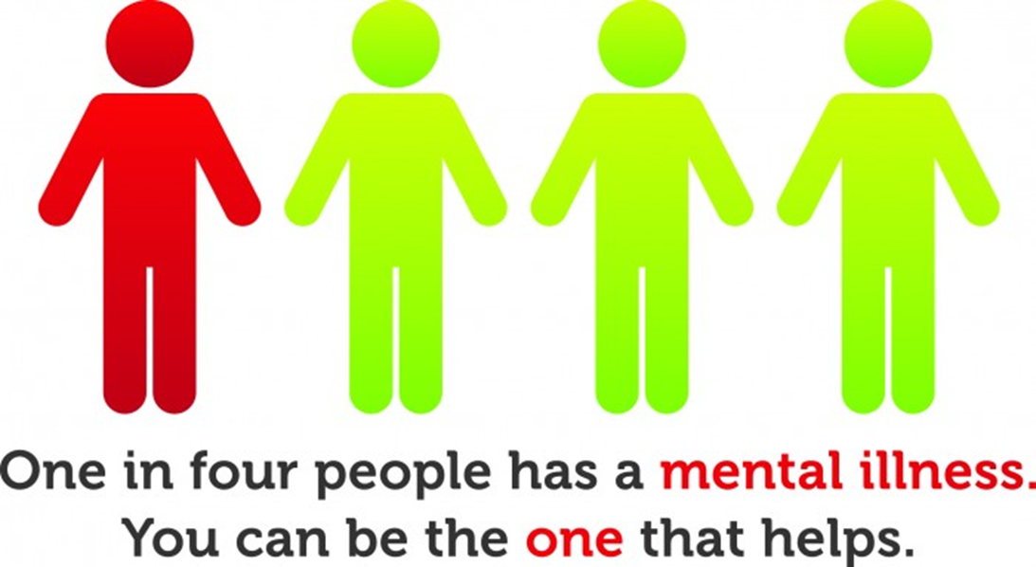
PREVENTION/EARLY INTERVENTION (PEI) Programs/Services

Slide 28

BE A STAR PROJECT
Coordinated system in Berkeley to identify children age 0-5 at risk of developmental delay, and social/emotional/behavioral concerns.
Triage, assessment, referral, and treatment to community based or specialist services for children who are screened positive.

Slide 29

SUPPORTIVE SCHOOLS PROJECT
Transforms school culture towards a preventive, positive, and supportive approach to managing problem behavior.
Provides individual and group mental health services for children in need.

Slide 30
ADDITIONAL SCHOOL PROJECTS
High School Youth Prevention Project: Provides mental health services and supports at Berkeley High and B-Tech for youth who are experiencing various stressors.
Mental and Emotional Education Team (MEET): Trains student peers to conduct class presentations on common mental health disorders, area resources, and basic coping and intervention skills.
Dynamic Mindfulness (DMind) Project: An evidence based intervention that integrates mindful action, breathing, and centering into classroom and afterschool sessions.

Slide 31

ADDITIONAL SCHOOL PROJECTS
African American Success Project
Project in BUSD middle school for students and their families to actively engage in the classroom and school life while creating a pathway for long-term success.

Slide 32

COMMUNITY EDUCATION/SUPPORTS
Program Components
Outreach & Engagement
Support Groups
Community Education
Building Leaders
Consultation/Training
Target Groups: • African Americans • Latinos
• LGBTQIA+ • Older Adults • TAY

Slide 33
SOCIAL INCLUSION
Anti-Stigma Project, “Telling Your Story”.
Consumer and family member–led education effort.
Consumer presentations to schools and community organizations to dispel myths, attitudes, and discrimination around mental health clients and issues

Slide 34


CALIFORNIA MENTAL HEALTH SERVICES AUTHORITY (CalMHSA)
A State Joint Powers Authority that provides local resources on:
Suicide Prevention
Student Mental Health
Stigma and Discrimination

Slide 35
MENTAL HEALTH PROMOTION CAMPAIGN

Slide 36
Proposed FY24 Additions Through PEI Funds
PROGRAM | POSITION | Cost
High School Prevention Project | .8 Mental Health Program Supervisor: Will oversee and direct the High School Prevention Project. | $168,452
High School Prevention Project | 1.0 Behavioral Health Clinician II: Will provide Mental Health services and supports to youth. | $77,172
High School Prevention Project | .30 Social Services Specialist: Will provide supportive Substance Use Disorder (SUD) services to youth. | $39,835
High School Prevention Project | 1.0 Community Services Specialist II: Serves as the Mental Health and Well-being Coordinator at the Berkeley High Schools. Will work with the High School Mental Health Program Supervisor to strengthen and expand mental health services/resources and address equity concerns and unmet Mental Health needs for High School age youth | $165,982
Administration | .40 Associate Management Analyst: Will serve as a contract content manager for the Division. (.40 PEI Admin; .60 CSS Admin) | $73,012
TOTAL |  | $524,453

Slide 37
PEI FY24-FY26 PROJECTED REVENUE
FY24 | FY25 | FY26
$2,325,669 | $1,151,455 | $1,135,882

Slide 38

PEI FY24 PROJECTED FUNDS
Estimated FY24 Revenue: $2,325,669
Estimated Unspent Amount: +$2,437,727 $4,763,396

Slide 39
PEI FY24 TOTAL PROJECTED EXPENDITURES
PROGRAM | FY24
Be A Star | $38,550
High School Prevention Project | $865,280
BUSD Projects (Supportive Schools; MEET; African American Success Project: & DMIND) | $401,389
Community Education & Supports | $364,092
Social Inclusion | $9,000
CalMHSA PEI Statewide Prevention & Early Intervention Project | $97,082
Mental Health Promotion Campaign | $100,000
PEI Administration | $455,313
TOTAL FY24 ESTIMATED EXPENDITURES | $2,330,706

Slide 40

PEI FY24 FUNDS
Total Estimated Funds: $4,763,396
Estimated FY24 Expenditures: - $2,330,706 $2,432,690

Slide 41

INNOVATIONS (INN)
Programs/Services

Slide 42

HELP@HAND PROJECT
( Formerly named Technology Suite)
This project has made the HeadSpace and MyStrength Apps available for free on a short term basis for anyone who lives, works or goes to school in Berkeley. The Apps can be accessed by community members on an at-will, voluntary basis.
To assess whether an App that would assist individuals in recognizing signs and symptoms of mental health concerns, would promote better mental health outcomes;
To assess whether the provision of technology-based services would increase access to mental health services.

Slide 43
MOBILE WELLNESS CENTER PROJECT
Mobile wellness center to visit various homeless encampment locations to provide on-site customized services, resources, and linkages.
Led by peers with lived experience of homelessness, and include partners from encampment communities to encourage participation, help define service needs, and support service provision at the site.
To assess whether on-site wellness center services have a positive impact on mental health outcomes.

Slide 44
INN PROJECTED REVENUE
FY24 | FY25 | FY26
$612,018 | $303,014 | $298,916

Slide 45
INN FY24 PROJECTED FUNDS
Estimated FY24 Revenue: $612,018
Estimated Unspent Amount: +$1,857,707 $2,470,725

Slide 46

INN FY24 TOTAL PROJECTED EXPENDITURES
PROGRAM | FY24
Help@Hand Project | $22,159
Encampment-Based Mobile Wellness Center Project | $1,201,000
TOTAL FY24 PROJECTED EXPENDITURES | $1,223,159

Slide 47

INN FY24 FUNDS
Total Estimated Funds: $2,470,725
Estimated FY24 Expenditures: - $1,223,159 $1,247,566

Slide 48

WORKFORCE, EDUCATION & TRAINING (WET)

Slide 49

WET SERVICES
Loan Repayment Program – Through the Greater Bay Area Workforce, Education and Training Regional Partnership.
Workforce Development Coordinator - $170,535

Slide 50

CAPITAL FACILITIES & TECHNOLOGICAL NEEDS (CFTN)

Slide 51
NEXT STEPS
Write the Draft MHSA Three Year Plan
Conduct a 30 Day Public Review of Draft Plan
Conduct a Public Hearing at a Mental Health Commission Meeting
Obtain approval from City Council
Submit approved plan to the Department of Health Care Services (DHCS) and the Mental Health Oversight and Accountability Commission (MHSOAC)

Slide 52

COMMENTS/QUESTIONS/COMMUNITY INPUT

Slide 53
CONTACT INFORMATION & RESOURCES
MHSA Coordinator
Karen Klatt, M.Ed.
(510) 849-7541
(510) 981-7644
KKlatt@cityofberkeley.info or KKlatt@berkeleyca.gov
City of Berkeley MHSA Website
www.ci.berkeley.ca.us/mentalhealth
*(follow link to MHSA webpage)

Slide 54
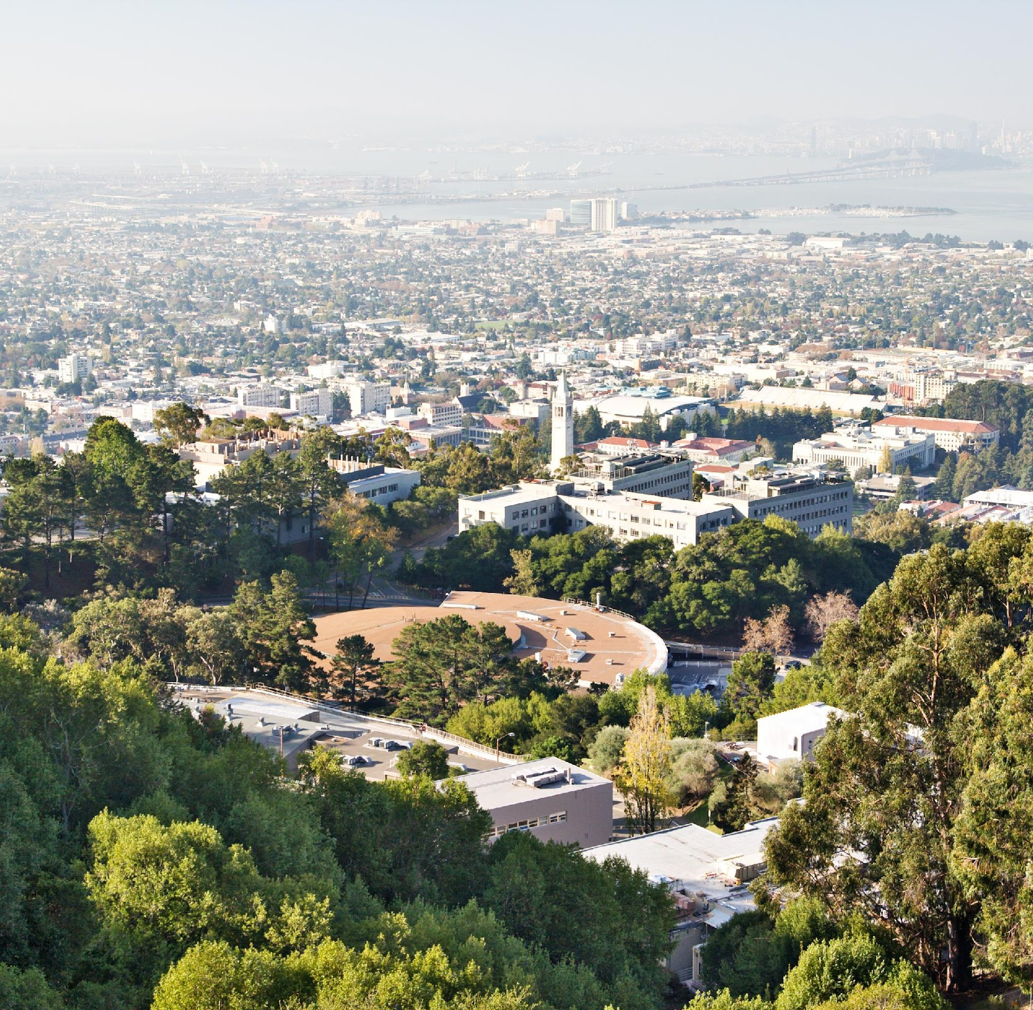

Thank you!
Karen Klatt KKlatt@cityofberkeley.info
Kklatt@berkeleyca.gov

